Slide 1





Consulting
Services
Efficiency, Control & Governance Solutions for Stronger, Smarter, Scalable Enterprises
Overview Presentation
Partnering with boards, promoters, and CXOs to translate vision into execution with clarity and measurable results.
Est. 1998
www.kolath.in
Pan-India & Global Presence

Slide 2
















Our Value Proposition
We partner with boards, promoters, and CXOs to translate vision into execution with clarity, governance, and measurable results.
Data-Driven Insights
Actionable Recommendations
Evidence-based diagnostics and benchmarking to identify opportunities and understand your competitive landscape with precision.
Clear roadmaps and prioritised initiatives that translate strategic thinking into executable plans with defined milestones.
End-to-End Implementation Support
Measurable ROI
PMO services, change management, and capability building to ensure seamless execution and sustainable transformation.
KPIs, dashboards, and benefits tracking systems that demonstrate tangible value and enable continuous improvement.
2

Slide 3






Why KOLATH
Four key differentiators that set us apart in consulting excellence
Customised Solutions
Sustainable Outcomes
Industry-specific expertise tailored to your unique challenges. We understand that every organization has distinct needs and deliver bespoke strategies that address your specific context and goals.
Long-term value creation, not just quick fixes. We focus on building enduring capabilities and resilient systems that drive continuous improvement and lasting competitive advantage.
Integrated Approach
Seasoned Professionals
Strategy + Governance + Execution in one unified framework. We seamlessly connect strategic planning with operational implementation, ensuring alignment across all organizational levels.
Cross-industry expertise with a proven track record. Our consultants bring deep functional knowledge and real-world experience from diverse sectors, delivering insights that make a difference.
3

Slide 4












Core Consulting Services
Four integrated pillars supporting your strategic objectives and sustainable growth
Growth & Strategic Advisory
Capital, Funding & Transaction Advisory
Accelerate performance and unlock growth through strategic planning, leadership coaching, and operational excellence
Optimize capital structure and enable strategic deals through expert fundraising and M&A advisory services
Sustainability, ESG & Responsible Growth
Market Entry & International Expansion
De-risk market entry and scale across borders with comprehensive market strategy and localization support
Build resilient, responsible enterprises through integrated ESG strategy and performance management
4

Slide 5








Growth & Strategic Advisory
What We Do
Benefits & Outcomes
Business Coaching & Leadership Advisory
Leadership alignment and execution cadence with 90-day sprint methodology
Turnaround & Performance Improvement
EBITDA and productivity uplift of 10-30% through operational excellence
Clear OKRs and scorecards with governance rhythm for sustained performance
Growth Strategy Development
Proven Results Across 100+ Engagements
Revenue growth • Margin expansion • Cycle time reduction
5
Consistent Performance Growth

Slide 6



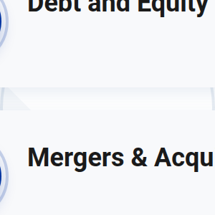

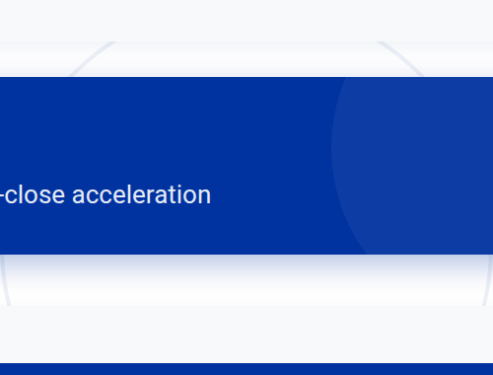
Capital, Funding & Transaction Advisory
What We Do
Benefits & Outcomes
Fund Raising Advisory
Optimised capital structure and improved cost of capital for sustainable growth
Investor readiness with compelling equity story and strategic positioning
Debt and Equity Structuring
Efficient deal execution and synergy realisation in M&A transactions
Mergers & Acquisitions Advisory
Robust governance frameworks ensuring compliance and covenant adherence
Strategic Capital Solutions
Cost of funds optimization • Time-to-close acceleration
6
Capital Efficiency Growth

Slide 7

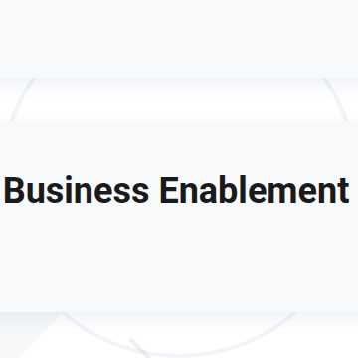

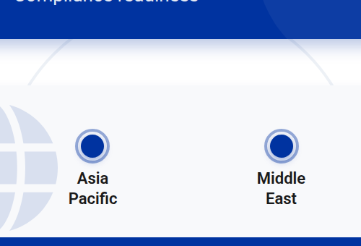

Market Entry & International Expansion
What We Do
Benefits & Outcomes
Market Entry Strategy
Accelerated market access via partner ecosystems and local networks
Regulatory navigation and localisation for seamless operations
India Business Enablement
Scalable go-to-market operating model for sustainable growth
Proven International Expansion Playbooks
Country scans • Partner frameworks • Compliance readiness
North
America
Europe
Asia
Pacific
Middle
East
7

Slide 8


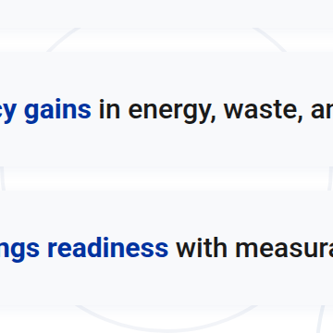
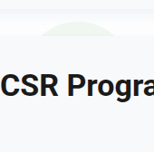
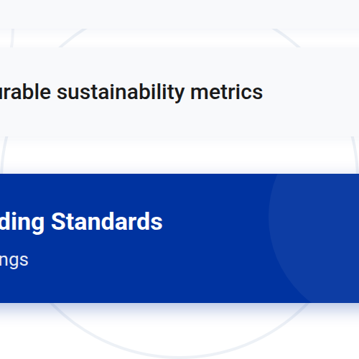


Sustainability, ESG & Responsible Growth
What We Do
Benefits & Outcomes
Sustainability & ESG Strategy
Enhanced stakeholder trust and risk mitigation through transparent practices
ESG Performance Measurement & Reporting
Compliance with global standards and comprehensive ESG disclosures
Efficiency gains in energy, waste, and water management
CSR Programme Design
ESG ratings readiness with measurable sustainability metrics
DEI & Ethical Supply Chain Initiatives
Frameworks Aligned to Leading Standards
GRI • SASB • TCFD • SDGs • ESG Ratings
8

Slide 9



















Our Approach / Methodology
A systematic 5-phase framework delivering measurable results through structured execution
1
2
3
4
5
Assess
Strategize
Implement
Monitor
Optimize
Diagnose current state through data analysis and stakeholder insights
PMO-led execution with change management and enablement
Track KPIs with governance cadence and course-correct
Scale wins and institutionalise practices for continuous improvement
Prioritise initiatives and build business case with roadmap
9

Slide 10















Supporting Business Services
Audit & Assurance
Valuation, TEV & DPR
Independent reviews and assurance services to enhance credibility and stakeholder confidence
Financial models and detailed project reports for informed decision-making and valuation analysis
IPR & Legal Support
Transfer Pricing & Tax Support
IP protection and contract management to safeguard your intellectual assets and legal interests
Compliance and advisory services for optimized tax structures and regulatory adherence
10

Slide 11























CONTACT US
CALL US
EMAIL US
VISIT US
+91 94971 36863
business@kolath.in
www.kolath.in
+91 94471 36863
INDIA PRESENCE
GLOBAL REACH
Mumbai
Delhi
Kolkata
Chennai
Bengaluru
Singapore
UK
Canada
USA
Kenya
Kochi
KOLATH® Financial Consulting Private Limited
EFFICIENCY | CONTROL | GOVERNANCE | VALUE CREATION
11

